Slide 1
ServiceX for CMS
Select and transform large datasets into analysis-ready data using Python.

Slide 2
Git Newest Changes
git stash
git pull
git stash pop

Slide 3
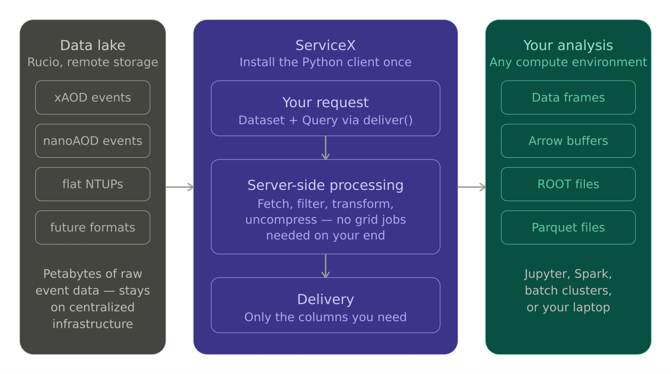
What is ServiceX?

Slide 4
Why Use ServiceX?
Simplifies and unifies data delivery
Reduces files size and branches
Quick and easy skimming and filtering
Run on many datasets and files without the grid

Slide 5
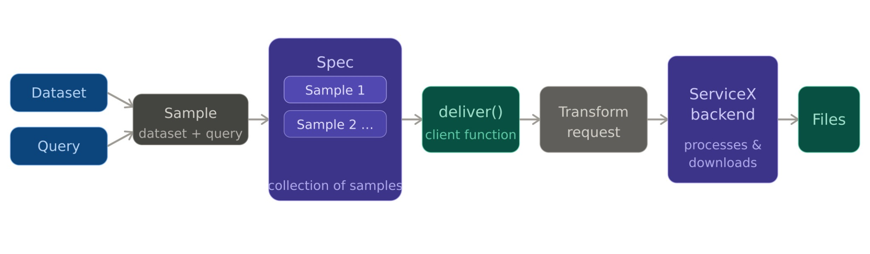
Generic ServiceX Workflow

Slide 6
Backend Authentication
ServiceX for CMS is currently in testing
Does not have full user authentication
No ready for full analysis use
Looking for help testing it (Be on the cutting edge of HEP software!)
servicex.yaml
Used to authenticate
Located in ServiceX folder in repo
Will work after workshop, not forever
Please let use know if you want to keep using ServiceX

Slide 7
15 Minute Histogram Challenge!
See how quick you can get results

Slide 8
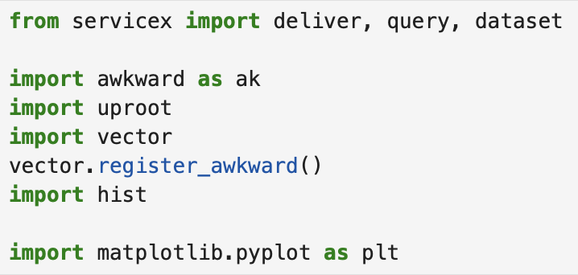
Setup Imports

Slide 9
Generic ServiceX Workflow

Slide 10
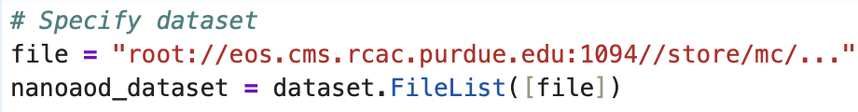
Specify dataset

Slide 11
Generic ServiceX Workflow

Slide 12
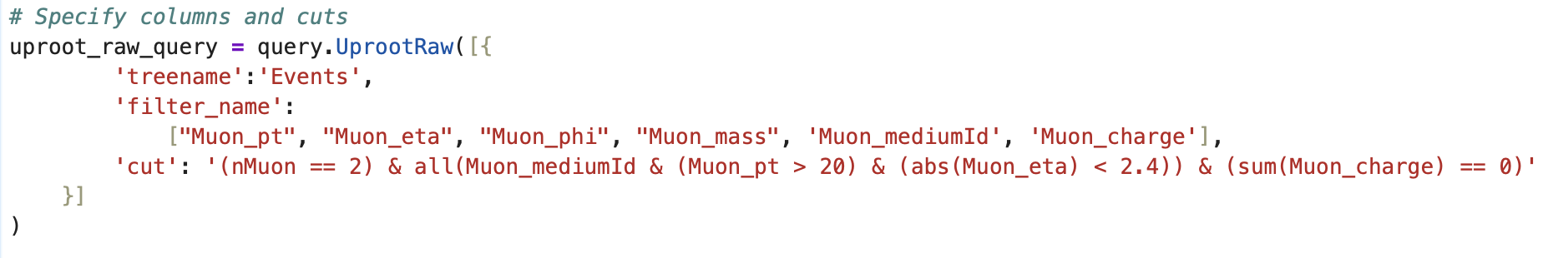
Build Query

Slide 13
Generic ServiceX Workflow

Slide 14
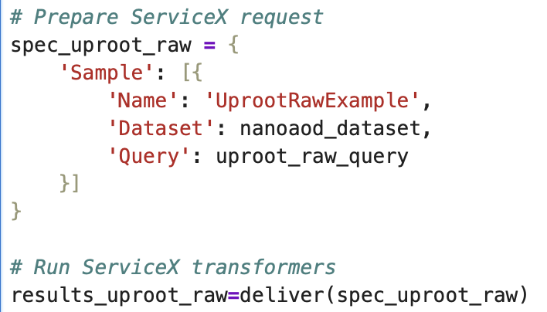
Setup and Deliver Spec

Slide 15
Generic ServiceX Workflow

Slide 16
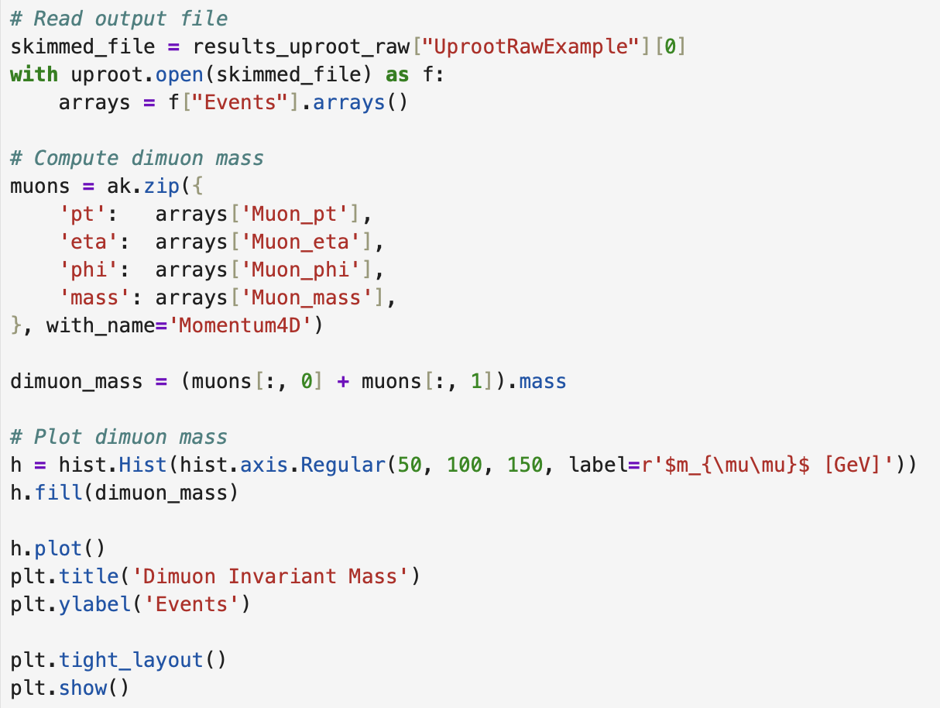
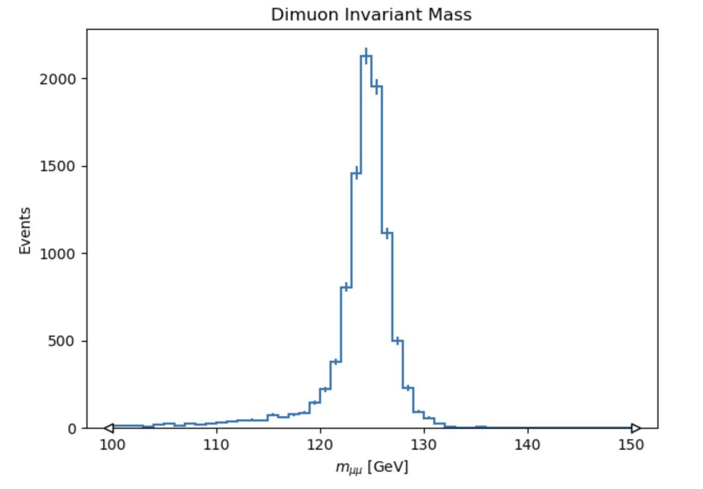
Run our Analysis!

